Slide 1
Quick Introduction to Javascript World
Prepared by Burak Buruk

Slide 2
Traditional way “Multiple-page application”
Multiple-page applications work in a “traditional” way. Every change eg. display the data or submit data back to server requests rendering a new page from the server in the browser.

Slide 3
Single Page Applications
A single-page application is an app that works inside a browser and does not require page reloading during use. You are using this type of applications every day. These are, for instance: Gmail, Google Maps, Facebook or GitHub.
SPAs are all about serving an outstanding UX by trying to imitate a “natural” environment in the browser — no page reloads, no extra wait time. It is just one web page that you visit which then loads all other content using JavaScript — which they heavily depend on.

Slide 4
Server Rendered SPA
Most modern JavaScript frameworks are working on ways to handle server-side rendering of SPAs — meaning the user would get a fully populated page when the SPA is loaded for the first time, instead of, for example, seeing a loading indicator.
Server-side rendering can alleviate some of the burden browsers have to go through when rendering pages, and will also help with the problem of SEO and content discoverability.

Slide 5
Nodejs
Node.js® is a JavaScript runtime built on Chrome's V8 JavaScript engine. Node.js uses an event-driven, non-blocking I/O model that makes it lightweight and efficient. Node.js' package ecosystem, npm, is the largest ecosystem of open source libraries in the world.

Slide 6
Npm
npm is the package manager for JavaScript and the world’s largest software registry.
Comes with nodejs.
Nexus repo intranet
Configure it from .npmrc file under user

Slide 7
Javascript Interpreted
JavaScript code needs a tool (JS engine) installed in your machine (node, browser) to get executed.
Errors only shown when they are executed.

Slide 8
Does JavaScript execute top to bottom?
The answer is YES.
It's an imperative structured object-oriented prototype based scripting language.
<script src="http://your.cdn.com/first.js" type="text/javascript"></script>
<script src="http://your.cdn.com/second.js" type="text/javascript"></script>

Slide 9
What is the HTML DOM?
The HTML DOM is a standard object model and programming interface for HTML. It defines:
The HTML elements as objects
The properties of all HTML elements
The methods to access all HTML elements
The events for all HTML elements

Slide 10

DOM
When a web page is loaded, the browser creates a Document Object Model of the page.

Slide 11
Accessing Elements by ID
The easiest way to access a single element in the DOM is by its unique ID. We can grab an element by ID with the getElementById() method of the document object.
document.getElementById();

Slide 12
“use strict”
Declared at the beginning of a script, it has global scope (all code in the script will execute in strict mode):
"use strict";
x = 3.14; // This will cause an error because x is not declared
x = 3.14; // This will not cause an error.
myFunction();
function myFunction() {
"use strict";
y = 3.14; // This will cause an error
}

Slide 13
Javascript History
1995: JavaScript is born as LiveScript
1997: ECMAScript standard is established
1999: ES3 comes out and IE5 is all the rage
2000–2005: XMLHttpRequest, a.k.a. AJAX, gains popularity in app such as Outlook Web Access (2000) and Oddpost (2002), Gmail (2004) and Google Maps (2005).
2009: ES5 comes out (this is what most of us use now) with forEach, Object.keys, Object.create (specially for Douglas Crockford), and standard JSON
2015: ES6/ECMAScript2015 comes out; it has mostly syntactic sugar, because people weren’t able to agree on anything more ground breaking.
2016: ES7/ECMAScript2016 Seventh edition of ECMAScript.
2017: ES8/ECMAScript2017 Eighth edition of ECMAScript.

Slide 14
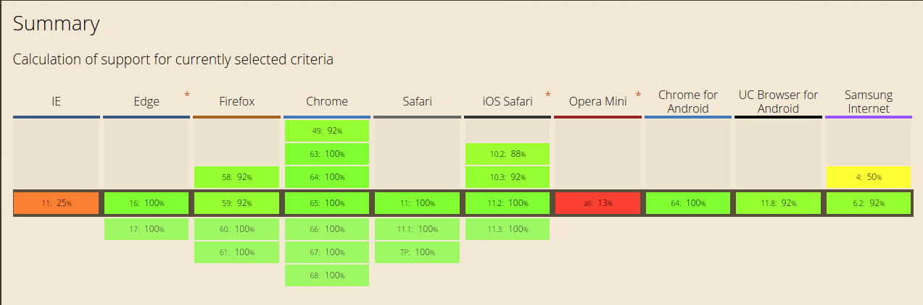
ES 6 Supported Browsers

Slide 15
ES 6
Default Parameters in ES6 *
Template Literals in ES6
Multi-line Strings in ES6
Destructuring Assignment in ES6
Enhanced Object Literals in ES6
Arrow Functions in ES6 *
Promises in ES6 *
Block-Scoped Constructs Let and Const *
Classes in ES6 *
Modules in ES6 *

Slide 16
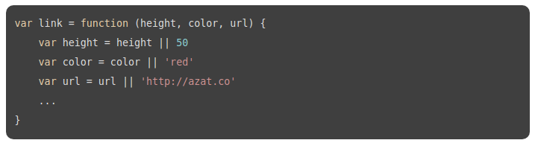
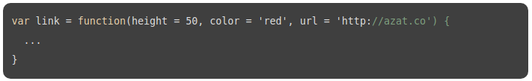
Default Parameters in ES6

Slide 17
Arrow Functions in ES6
(event) =>{
this.sendData()
}
The parenthesis () are optional for single params in an arrow function signature. You need them when you use more than one param.

Slide 18
Array functions Map
map calls a provided callback function once for each element in an array, in order, and constructs a new array from the results.
var array1 = [1, 4, 9, 16];
// pass a function to map
const map1 = array1.map(x => x * 2);
console.log(map1);
// expected output: Array [2, 8, 18, 32]

Slide 19
Array functions Reduce
reduce() executes the callback function once for each element present in the array, excluding holes in the array, receiving four arguments
accumulator
currentValue
currentIndex
array
const array1 = [1, 2, 3, 4];
const reducer = (accumulator, currentValue) => accumulator + currentValue;
// 1 + 2 + 3 + 4
console.log(array1.reduce(reducer));
// expected output: 10
// 5 + 1 + 2 + 3 + 4
console.log(array1.reduce(reducer, 5));
// expected output: 15

Slide 20
Array functions Filter
filter() calls a provided callback function once for each element in an array, and constructs a new array of all the values for which callback returns a value that coerces to true.
var words = ['spray', 'limit', 'elite', 'exuberant', 'destruction', 'present'];
const result = words.filter(word => word.length > 6);
console.log(result);
// expected output: Array ["exuberant", "destruction", "present"]

Slide 21
Block-Scoped Constructs Let
The let statement declares a block scope local variable, optionally initializing it to a value.
Variables declared by let have as their scope the block in which they are defined, as well as in any contained sub-blocks. In this way, let works very much like var. The main difference is that the scope of a var variable is the entire enclosing function.

Slide 22
Let vs Var
function varTest() {
var x = 1;
if (true) {
var x = 2; // same variable!
console.log(x); // 2
}
console.log(x); // 2
}
function letTest() {
let x = 1;
if (true) {
let x = 2; // different variable
console.log(x); // 2
}
console.log(x); // 1
}

Slide 23
Block-Scoped Constructs Const
Constants are block-scoped, much like variables defined using the let statement. The value of a constant cannot change through re-assignment, and it can't be redeclared.
const number = 42;
try {
number = 99;
} catch(err) {
console.log(err);
// expected output: TypeError: invalid assignment to const `number'
// Note - error messages will vary depending on browser
}
console.log(number);
// expected output: 42

Slide 24
Classes in ES6
class Rectangle {
constructor(height, width) {
this.height = height;
this.width = width;
}
// Getter
get area() {
return this.calcArea();
}
// Method
calcArea() {
return this.height * this.width;
}
}
const square = new Rectangle(10, 10);
console.log(square.area); // 100
class Rectangle {
constructor(height, width) {
this.height = height;
this.width = width;
}
}
var p = new Rectangle(); // ReferenceError
class Rectangle {}

Slide 25
Sub classing with extends
If there is a constructor present in subclass, it needs to first call super() before using "this".
An ECMAScript class can only have a single superclass, so multiple inheritance from tooling classes, for example, is not possible.
class Cat {
constructor(name) {
this.name = name;
}
speak() {
console.log(this.name + ' makes a noise.');
}
}
class Lion extends Cat {
speak() {
super.speak();
console.log(this.name + ' roars.');
}
}
var l = new Lion('Fuzzy');
l.speak();
// Fuzzy makes a noise.
// Fuzzy roars.

Slide 26
Static Methods
The static keyword defines a static method for a class. Static methods are called without instantiating their class and cannot be called through a class instance.
Static methods are often used to create utility functions for an application.

Slide 27
Static Method Example
class Point {
constructor(x, y) {
this.x = x;
this.y = y;
}
static distance(a, b) {
const dx = a.x - b.x;
const dy = a.y - b.y;
return Math.hypot(dx, dy);
}
}
const p1 = new Point(5, 5);
const p2 = new Point(10, 10);
console.log(Point.distance(p1, p2)); // 7.0710678118654755

Slide 28
Modules in ES6
The export statement is used when creating JavaScript modules to export functions, objects, or primitive values from the module so they can be used by other programs with the import statement.
export { name1, name2, …, nameN };
export { variable1 as name1, variable2 as name2, …, nameN };
export let name1, name2, …, nameN; // also var
export let name1 = …, name2 = …, …, nameN; // also var, const
export function FunctionName(){...}
export class ClassName {...}
export default expression;
export default function (…) { … } // also class, function*
export default function name1(…) { … } // also class, function*
export { name1 as default, … };
export * from …;
export { name1, name2, …, nameN } from …;
export { import1 as name1, import2 as name2, …, nameN } from …;
export { default } from …;

Slide 29
Export Examples
There are two different types of export, named and default. You can have multiple named exports per module but only one default export. Each type corresponds to one of the above syntax
Named exports:// exports a function declared earlier
export { myFunction };
// exports a constant
export const foo = Math.sqrt(2);
Default exports (function):export default function() {}
Default exports (class):export default class {}

Slide 30
Import
Named exports are useful to export several values. During the import, it is mandatory to use the same name of the corresponding object.
But a default export can be imported with any name for example:
export default k = 12; // in file test.js
import m from './test' // note that we have the freedom to use import m instead of import k, because k was default export
console.log(m); // will log 12

Slide 31
Export and Import
// module "my-module.js"
function cube(x) {
return x * x * x;
}
const foo = Math.PI + Math.SQRT2;
var graph = {
options:{
color:'white',
thickness:'2px'
},
draw: function(){
console.log('From graph draw function');
}
}
export { cube, foo, graph };
import { cube, foo, graph } from 'my-module';
graph.options = {
color:'blue',
thickness:'3px'
};
graph.draw();
console.log(cube(3)); // 27
console.log(foo); // 4.555806215962888

Slide 32
Default Export
If we want to export a single value or to have a fallback value for our module, we could use a default export
Then, in another script, it will be straightforward to import the default export
Note that it is not possible to use var, let or const with export default.
// module "my-module.js"
export default function cube(x) {
return x * x * x;
}
import cube from 'my-module';
console.log(cube(3)); // 27

Slide 33
Promises in ES6
var p = new Promise((resolve, reject) => {
resolve(5);
});
p.then((val) => console.log(val)); // 5
p.catch((err) => console.log("error:", err.message));
// A Promise that throws, rather than explicitly reject
throw new Error("rejected!"); // same as rejection
var fetchJSON = function(url) {
return new Promise((resolve, reject) => {
$.getJSON(url)
.done((json) => resolve(json))
.fail((xhr, status, err) => reject(status + err.message));
});
}

Slide 34
Promise.all
The Promise.all(iterable) method returns a single Promise that resolves when all of the promises in the iterable argument have resolved or when the iterable argument contains no promises.
It rejects with the reason of the first promise that rejects.
Promise.all is rejected if any of the elements are rejected. For example, if you pass in four promises that resolve after a timeout and one promise that rejects immediately, then Promise.all will reject immediately.

Slide 35
Promise.all Example
var promise1 = Promise.resolve(3);
var promise2 = 42;
var promise3 = new Promise(function(resolve, reject) {
setTimeout(resolve, 100, 'foo');
});
Promise.all([promise1, promise2, promise3]).then(function(values) {
console.log(values);
});
// expected output: Array [3, 42, "foo"]

Slide 36
ES 7
Object Rest / Spread Properties
Observables
Async functions *

Slide 37
Async Functions
An async function can contain an await expression that pauses the execution of the async function and waits for the passed Promise's resolution, and then resumes the async function's execution and returns the resolved value.
Remember, the await keyword is only valid inside async functions. If you use it outside of an async function's body, you will get a SyntaxError.

Slide 38
Async Functions Example
function resolveAfter2Seconds() {
return new Promise(resolve => {
setTimeout(() => {
resolve('resolved');
}, 2000);
});
}
async function asyncCall() {
console.log('calling');
var result = await resolveAfter2Seconds();
console.log(result);
// expected output: "resolved"
}
asyncCall();

Slide 39
Do not confuse await for Promise.all
function resolveAfter2Seconds(x) {
return new Promise(resolve => {
setTimeout(() => {
resolve(x);
}, 2000);
});
}
async function add1(x) {
const a = await resolveAfter2Seconds(20);
const b = await resolveAfter2Seconds(30);
return x + a + b;
}
add1(10).then(v => {
console.log(v); // prints 60 after 4 seconds.
});
async function add2(x) {
const p_a = resolveAfter2Seconds(20);
const p_b = resolveAfter2Seconds(30);
return x + await p_a + await p_b;
}
add2(10).then(v => {
console.log(v); // prints 60 after 2 seconds.
});

Slide 40
Rewriting a promise chain with an async function
function getProcessedData(url) {
return downloadData(url) // returns a promise
.catch(e => {
return downloadFallbackData(url) // returns a promise
})
.then(v => {
return processDataInWorker(v); // returns a promise
});
}
async function getProcessedData(url) {
let v;
try {
v = await downloadData(url);
} catch(e) {
v = await downloadFallbackData(url);
}
return processDataInWorker(v);
}
Note that in the above example, there is no await statement on the return statement,
because the return value of an async function is implicitly wrapped in promise.resove.

Slide 41
New Project What will we use?
Npm
Webpack
Babel (js loader, css loader, style loader)
ES6-ES7
Nodejs for server
Axios for http requests
Material UI
Reactjs

Slide 42
Everything starts with npm init command
It will create a package.json
{
"name": "javascript-test",
"version": "1.0.0",
"description": "It creates a javascript template",
"main": "index.js",
"scripts": {
"build": "npm run clean && webpack",
"start": "npm run build && node server.js",
"clean": "rimraf build",
"test": "echo \"Error: no test specified\" && exit 1"
},
"repository": {
"type": "git",
"url": "git+https://github.com/burakburuk/javascript-test.git"
},
"author": "",
"license": "ISC",
….
}

Slide 43
dependencies and devDependencies
"devDependencies": {
"babel-cli": "^6.26.0",
"babel-core": "^6.26.0",
"babel-loader": "^7.1.2",
"babel-plugin-transform-class-properties": "^6.24.1",
"babel-preset-es2015": "^6.24.1",
"babel-preset-es2017": "^6.24.1",
"babel-preset-react": "^6.24.1",
"babel-preset-stage-2": "^6.24.1",
"css-loader": "^0.28.11",
"open": "0.0.5",
"raw-loader": "^0.5.1",
"react-core": "0.0.0",
"rimraf": "^2.6.2",
"webpack": "^3.10.0",
"webpack-dev-middleware": "^2.0.4",
"webpack-hot-middleware": "^2.21.0"
}
"dependencies": {
"axios": "^0.18.0",
"babel-polyfill": "^6.26.0",
"express": "4.16.2",
"material-ui": "^0.20.0",
"react": "^16.2.0",
"react-dom": "^16.2.0"
}

Slide 44
Webpack
Webpack is a module bundler.
Webpack can take care of bundling alongside a separate task runner.
React, and Hot Module Replacement (HMR) helped to popularize webpack and led to its usage in other environments, such as Ruby on Rails.
The smallest project you can bundle with webpack consists of input and output. The bundling process begins from user-defined entries.
Entries themselves are modules and can point to other modules through imports.
When you bundle a project using webpack, it traverses through imports, constructing a dependency graph of the project and then generating the output based on the configuration.

Slide 45
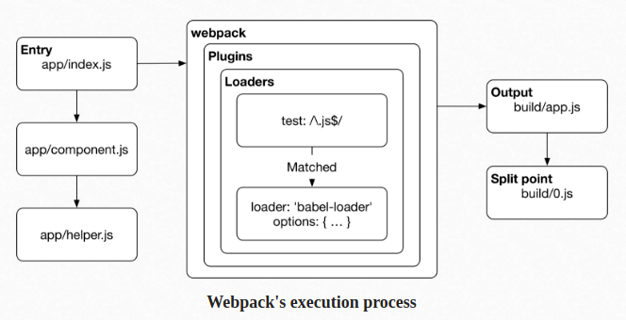
Webpack's Execution Process

Slide 46
Webpack.config.js
module.exports = {
devtool: 'inline-source-map',
resolve: {
alias: {}
},
entry: [
'babel-polyfill',
'webpack-hot-middleware/client',
path.resolve(__dirname, 'src/index.js')
],
output: {
path: path.resolve(__dirname, 'build'),
publicPath: '/',
filename: 'bundle.js'
},
module: {
loaders: [
{
test: /\.js?$/,
loader: 'babel-loader',
exclude: /node_modules/,
query: {
presets: ['es2015', 'react', 'stage-2']
}
},
{
test: /\.html$/,
loader: 'raw-loader'
},
{
test: /\.css$/,
loader: ['style-loader', 'css-loader']
}
]
},
plugins: [
new webpack.HotModuleReplacementPlugin(),
new webpack.NoEmitOnErrorsPlugin()
]
};

Slide 47
Webpack.config.js
devtool: 'inline-source-map' //for debug configuration
entry: [
'babel-polyfill',
'webpack-hot-middleware/client',
path.resolve(__dirname, 'src/index.js')
],
output: {
path: path.resolve(__dirname, 'build'),
publicPath: '/',
filename: 'bundle.js'
}

Slide 48
Webpack.config.js
//module loaders
loaders: [
{
test: /\.js?$/,
loader: 'babel-loader',
exclude: /node_modules/,
query: {
presets: ['es2015', 'react', 'stage-2']
}
},
{
test: /\.html$/,
loader: 'raw-loader'
},
{
test: /\.css$/,
loader: ['style-loader', 'css-loader']
}
]

Slide 49
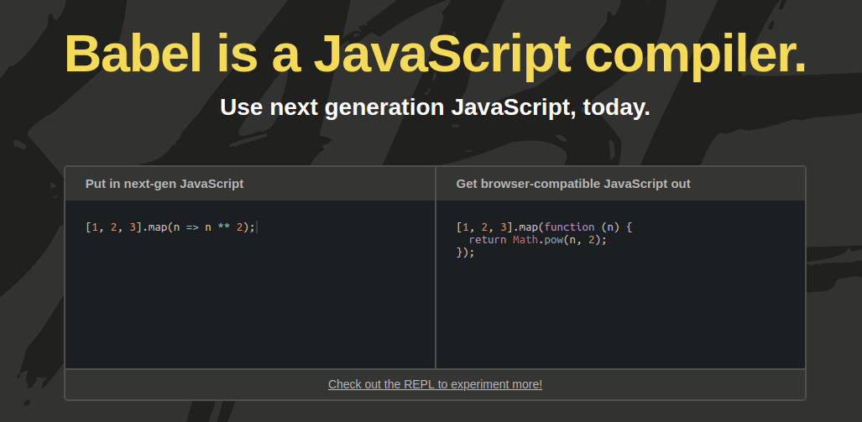
Babel

Slide 50
.babelrc
Ignores files or folders you specified.
{
"plugins": ["transform-react-jsx"],
"ignore": [
"foo.js",
"bar/**/*.js"
]
}

Slide 51
.babelrc - Use via package.json
{
"name": "my-package",
"version": "1.0.0",
"babel": {
// my babel config here
}
}

Slide 52
CSS into html
//mystyle.css
body {
background-color: lightblue;
}
h1 {
color: navy;
margin-left: 20px;
}
<head>
<link rel="stylesheet" type="text/css" href="mystyle.css">
</head>

Slide 53
CSS with webpack
Style-loader
Css-loader
loaders: [
{
test: /\.css$/,
loader: ['style-loader', 'css-loader']
}
]
import '../assets/main.css';

Slide 54
Axios Integration
axios.post('/user', {
firstName: 'Fred',
lastName: 'Flintstone'
})
.then(function (response) {
console.log(response);
})
.catch(function (error) {
console.log(error);
});
// Make a request for a user with a given ID
axios.get('/user?ID=12345')
.then(function (response) {
console.log(response);
})
.catch(function (error) {
console.log(error);
});

Slide 55
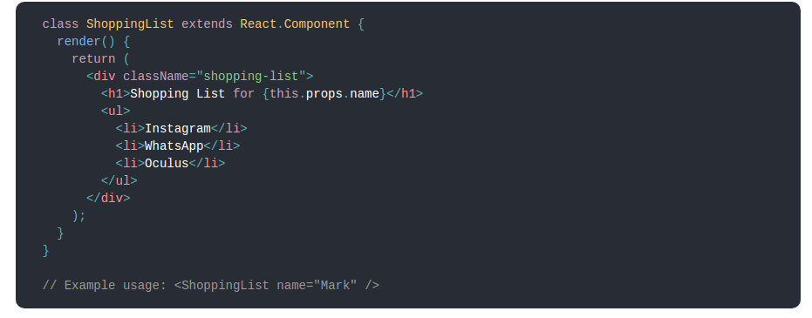
What is Reactjs
React is a declarative, efficient, and flexible JavaScript library for building user interfaces.
ReactJS basically is an open-source JavaScript library which is used for building user interfaces specifically for single page applications.
React also allows us to create reusable UI components.

Slide 56
Why React Js?
Simplicity
Easy to learn (Ironic)
Data Binding
Performance
Testability

Slide 57
JSX
In React, instead of using regular JavaScript for templating, it uses JSX.
class App1 {
render(){
return <Greeting firstName="Ben" lastName="Hector" />;
}
}
const App = () => {
return (
<div>
<Button kind="primary" onClick={() => console.log("clicked!")}>
Hello World!
</Button>
</div>
);
};

Slide 58
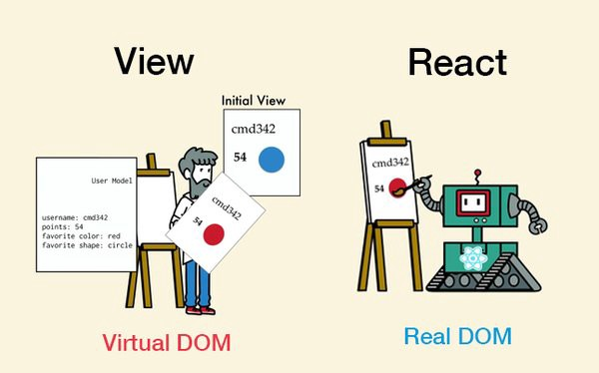
Virtual DOM
React creates an in-memory data structure cache which computes the changes made and then updates the browser.
React library only render components which actually change.

Slide 59
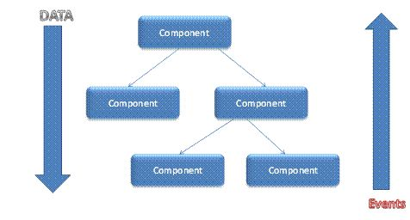
Single-Way data flow
Component cannot directly modify any properties but can pass a call back function with help of which we can do modifications.

Slide 60
React life cycle
Methods prefixed with will are called right before something happens.
Methods prefixed with did are called right after something happens.

Slide 61
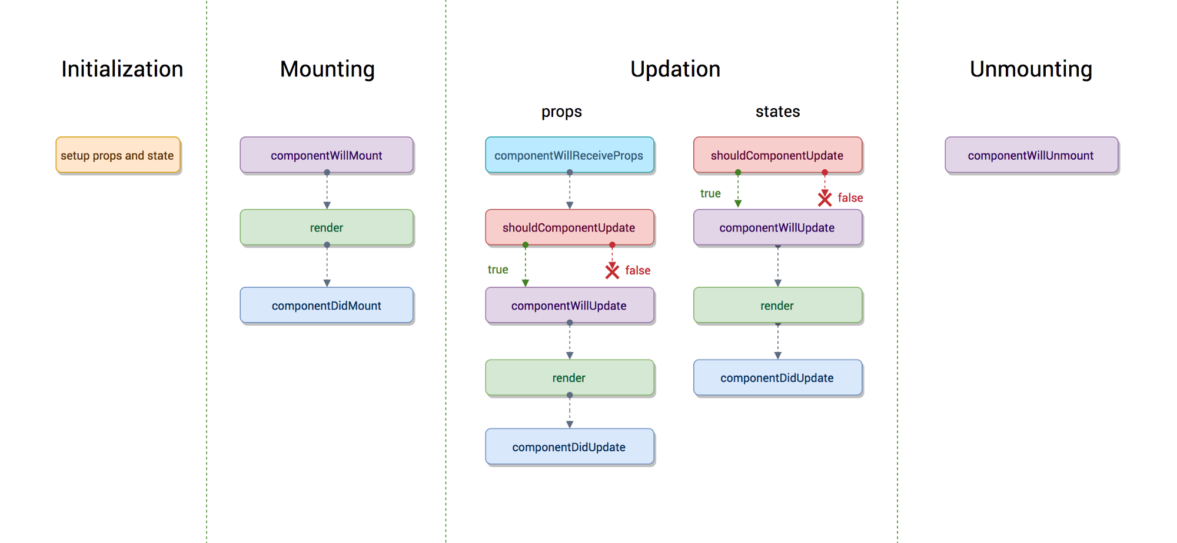
React life cycle

Slide 62
Mounting
These methods are called when an instance of a component is being created and inserted into the DOM:
constructor()
componentWillMount()
render()
componentDidMount()

Slide 63
componentDidMount()
componentDidMount() is invoked immediately after a component is mounted.
This is a good place to instantiate the network request from a remote endpoint.
Calling setState() in this method will trigger an extra rendering, but it will happen before the browser updates the screen.

Slide 64
Updating
An update can be caused by changes to props or state. These methods are called when a component is being re-rendered:
componentWillReceiveProps()
shouldComponentUpdate()
componentWillUpdate()
render()
componentDidUpdate()

Slide 65
shouldComponentUpdate()
Use shouldComponentUpdate() to let React know if a component’s output is not affected by the current change in state or props.
shouldComponentUpdate() is invoked before rendering when new props or state are being received.
Defaults to true.
This method is not called for the initial render or when forceUpdate() is used.

Slide 66
Unmounting
This method is called when a component is being removed from the DOM:
componentWillUnmount()

Slide 67
Error Handling
This method is called when there is an error during rendering, in a lifecycle method, or in the constructor of any child component.
componentDidCatch()

Slide 68
componentDidCatch()
Error boundaries are React components that catch JavaScript errors anywhere in their child component tree, log those errors, and display a fallback UI instead of the component tree that crashed.
Error boundaries catch errors during rendering, in lifecycle methods, and in constructors of the whole tree below them.

Slide 69
Some methods and properties
Instance Properties
props
State
Each component also provides some other APIs:
setState()
ForceUpdate()
Class Properties
DefaultProps
displayName

Slide 70
DefaultProps
If props.color is not provided, it will be set by default to 'blue'
If props.color is set to null, it will remain null
class CustomButton extends React.Component {
// ...
}
CustomButton.defaultProps = {
color: 'blue'
};

Slide 71
props
this.props contains the props that were defined by the caller of this component.
In particular, this.props.children is a special prop, typically defined by the child tags in the JSX expression rather than in the tag itself.

Slide 72
state
The state contains data specific to this component that may change over time. The state is user-defined, and it should be a plain JavaScript object.
If you don’t use it in render(), it shouldn’t be in the state. For example, you can put timer IDs directly on the instance.
Never mutate this.state directly, as calling setState() afterwards may replace the mutation you made. Treat this.state as if it were immutable.

Slide 73
setState()
setState() enqueues changes to the component state and tells React that this component and its children need to be re-rendered with the updated state.
Think of setState() as a request rather than an immediate command to update the component.
React does not guarantee that the state changes are applied immediately.
setState() will always lead to a re-render unless shouldComponentUpdate() returns false.
this.setState((prevState, props) => {
return {counter: prevState.counter + props.step};
});

Slide 74
React Component Constructor
The constructor for a React component is called before it is mounted.
The constructor is the right place to initialize state.
Just assign an object to this.state; don’t try to call setState() from the constructor.
The constructor is also often used to bind event handlers to the class instance.
constructor(props) {
super(props);
this.state = {
color: props.initialColor
};
}

Slide 75

Material UI Components

Slide 76
First React App
https://github.com/burakburuk/javascript-boilerplate

Slide 77
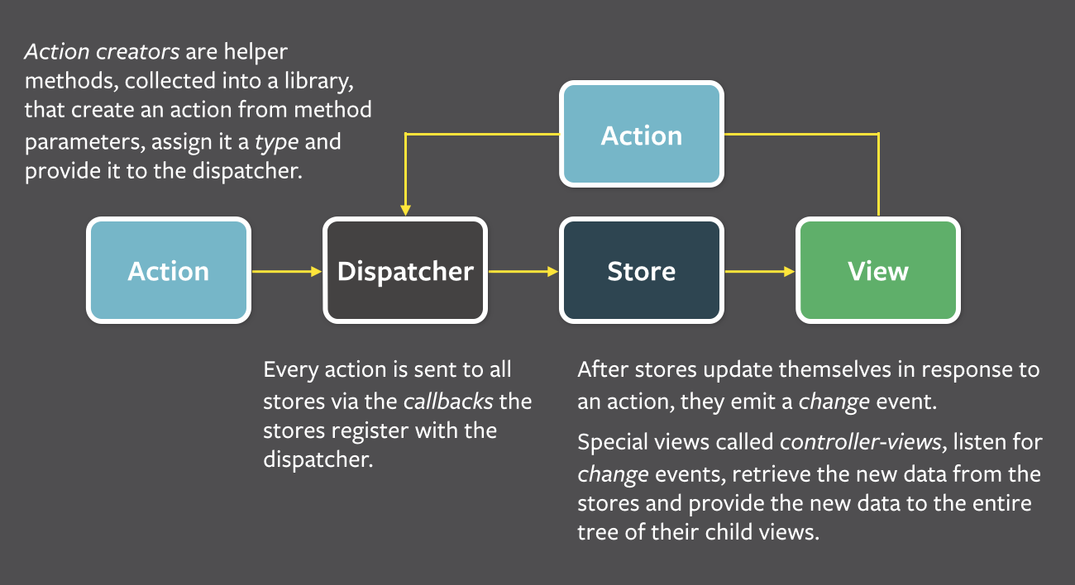
Flux

Slide 78
Redux
Redux has no relation to React.
You can write Redux apps with React, Angular, Ember, jQuery, or vanilla JavaScript.

Slide 79
References
https://webapplog.com/es6/
https://derickbailey.com/2017/06/06/3-features-of-es7-and-beyond-that-you-should-be-using-now/
https://www.npmjs.com/package/axios
https://www.w3schools.com/
https://caniuse.com/#search=es6
https://nodejs.org/en/
https://developer.mozilla.org/en-US/docs/Web/JavaScript/Reference/Classes
https://scotch.io/tutorials/setup-a-react-environment-using-webpack-and-babel
https://github.com/mui-org/material-ui

Slide 80
References
https://reactjs.org/tutorial/tutorial.html
https://github.com/burakburuk/javascript-boilerplate
http://www.material-ui.com/#/
https://redux.js.org/basics/usage-with-react

